Slide 1
Controversies
2024 Quarter 3 Lesson 03
Mark 1:21-3:35

Slide 2
The Gospel Story Continues…
As you remember from last week, John Mark begins his gospel account with a few words about John the Baptist, whose call for repentance prepared the way for Jesus’ ministry. Then there is the marvelous scene of Jesus’ baptism, where His identity was announced for all to hear by God the Father and the glorious, visible presence of the Holy Spirit. Then Mark gives an extremely brief account of the temptation in the wilderness and of Jesus’ recruitment of the first four disciples (Peter, Andrew, James and John). In Mark’s quick-moving fashion, the story moves on rapidly!

Slide 3
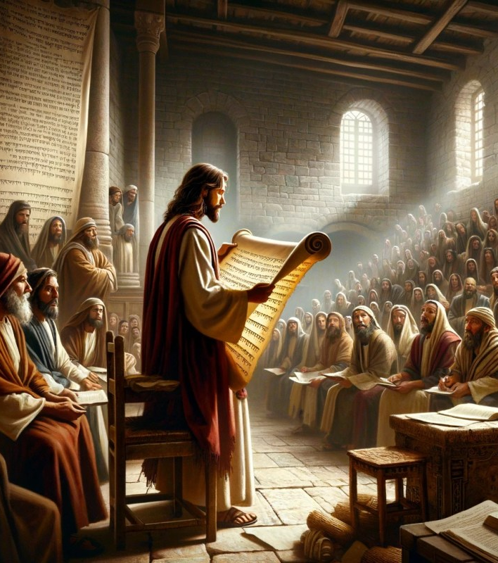
Authority
Mark 1:21-28
21 And they went into Capernaum; and straightway on the sabbath day he entered into the synagogue, and taught.
22 And they were astonished at his doctrine: for he taught them as one that had authority, and not as the scribes.

Slide 4
Authority
Strong’s Concordance
“
The Greek word translated as "authority" is exousia. Exousia means
(a) power, authority, weight, especially: moral authority, influence, (b) in a quasi-personal sense, derived from later Judaism, of a spiritual power, and hence of an earthly power.
”

Slide 5
He spoke as ONE with AUTHORITY…
This characteristic set the teaching of Christ in strong contrast with that of the scribes, and was commented on again and again by those who heard Him.
And some of them would have taken him; but no man laid hands on him. Then came the officers to the chief priests and Pharisees; and they said unto them, Why have ye not brought him? The officers answered, Never man spake like this man. –John 7:44-46

Slide 6
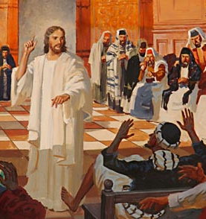
Authority
Mark 1:23-28
23 And there was in their synagogue a man with an unclean spirit; and he cried out,
24 Saying, Let us alone; what have we to do with thee, thou Jesus of Nazareth? art thou come to destroy us? I know thee who thou art, the Holy One of God.

Slide 7
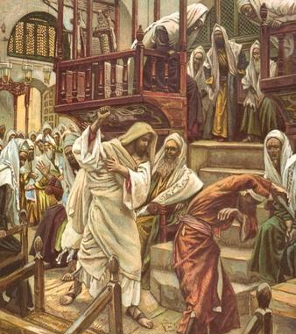
Authority
Mark 1:25-28
25 And Jesus rebuked him, saying, Hold thy peace, and come out of him.
26 And when the unclean spirit had torn him, and cried with a loud voice, he came out of him.

Slide 8
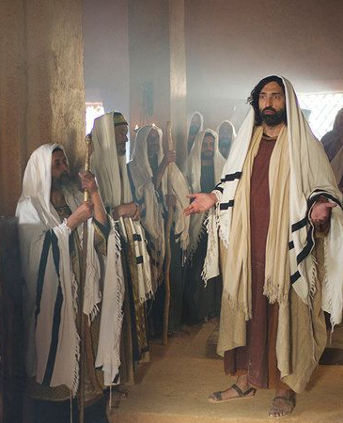
Authority
Mark 1:27-28
27 And they were all amazed, insomuch that they questioned among themselves, saying, What thing is this? what new doctrine is this? for with authority commandeth he even the unclean spirits, and they do obey him.
28 And immediately his fame spread abroad throughout all the region round about Galilee.

Slide 9
He spoke as ONE with AUTHORITY…
Instead of dwelling upon what men of past ages had thought and written, and appealing to this as authority, Jesus spoke forth as having authority in Himself directly from the Father. The scribes were wont to say that a certain rabbi had said thus and so, whereas Jesus declared, “I say unto you” (Matt. 5:21, 22).

Slide 10
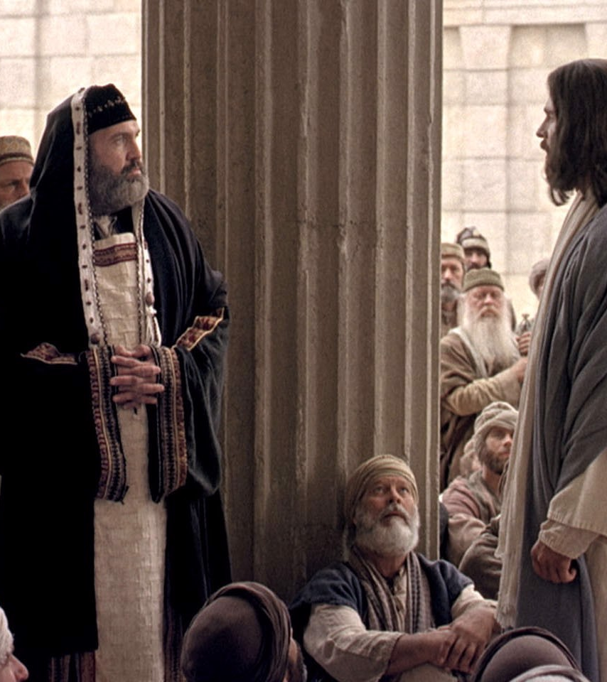
Authority
Matthew 21:23-27
23 And when he was come into the temple, the chief priests and the elders of the people came unto him as he was teaching, and said, By what authority doest thou these things? and who gave thee this authority?

Slide 11
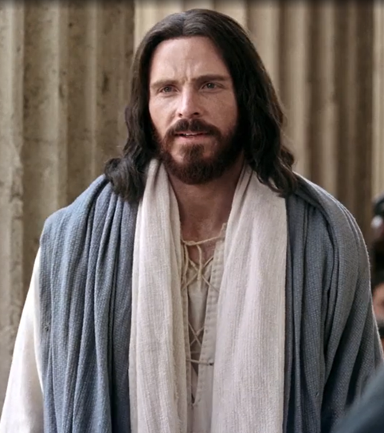
Authority
Matthew 21:24-27
24 And Jesus answered and said unto them, I also will ask you one thing, which if ye tell me, I in like wise will tell you by what authority I do these things.

Slide 12
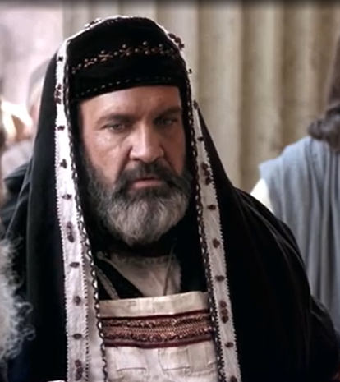
Authority
Matthew 21:25-27
25 The baptism of John, whence was it? from heaven, or of men? And they reasoned with themselves, saying, If we shall say, From heaven; he will say unto us, Why did ye not then believe him?
26 But if we shall say, Of men; we fear the people; for all hold John as a prophet.

Slide 13
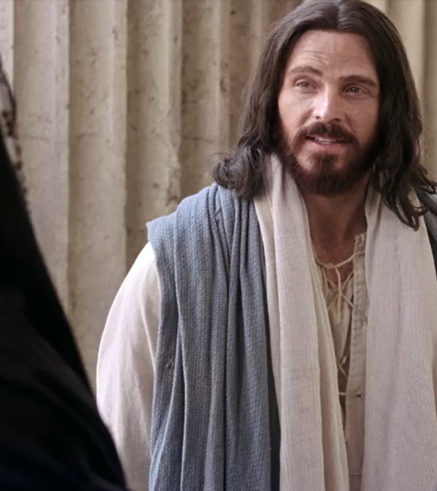
Authority
Matthew 21:27
27 And they answered Jesus, and said, We cannot tell. And he said unto them, Neither tell I you by what authority I do these things.

Slide 14
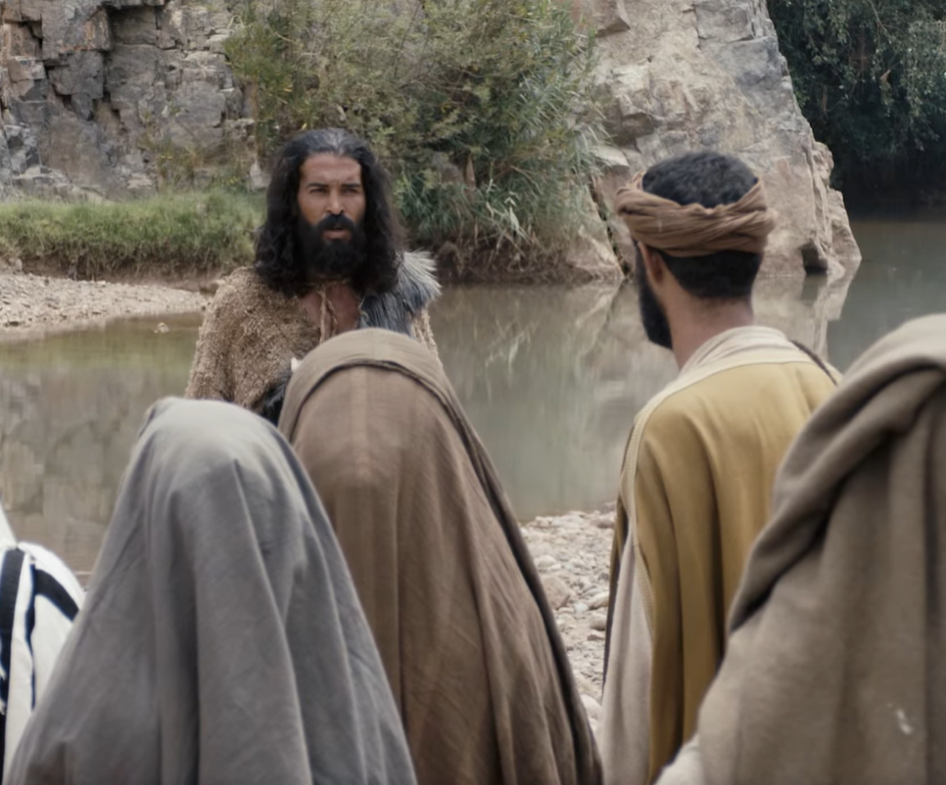
John the Baptist’s Authority Questioned
John 1:19-24
19 And this is the record of John, when the Jews sent priests and Levites from Jerusalem to ask him, Who art thou?
20 And he confessed, and denied not; but confessed, I am not the Christ.

Slide 15
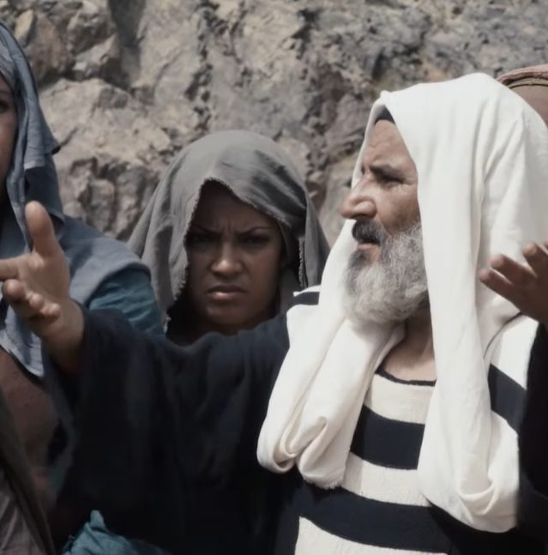
John the Baptist’s Authority Questioned
John 1:21-24
21 And they asked him, What then? Art thou Elias? And he saith, I am not. Art thou that prophet? And he answered, No.

Slide 16
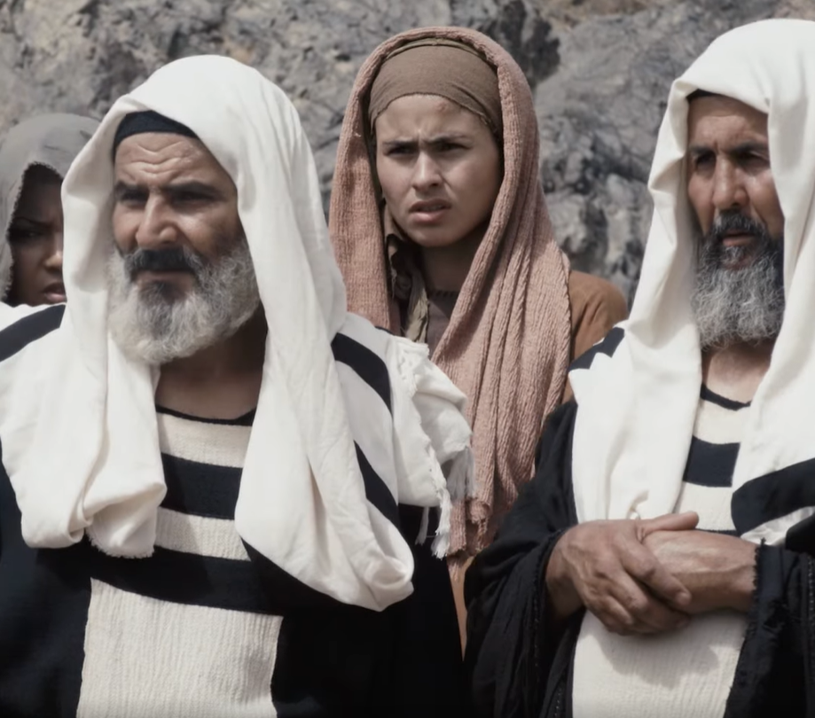
John the Baptist’s Authority Questioned
John 1:21-24
22 Then said they unto him, Who art thou? that we may give an answer to them that sent us. What sayest thou of thyself?

Slide 17
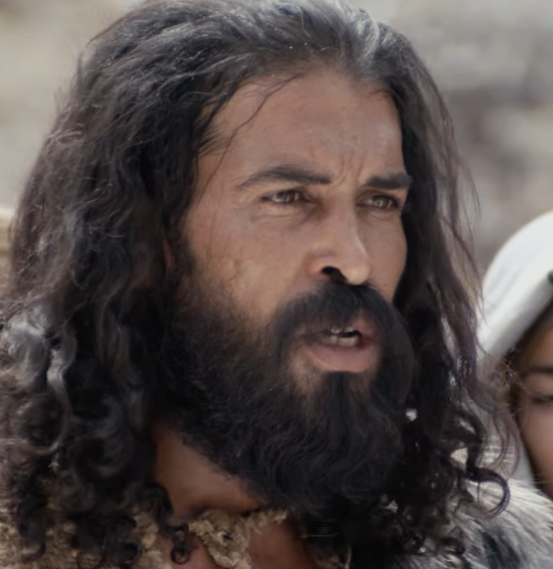
John the Baptist’s Authority Questioned
John 1:23-24
23 He said, I am the voice of one crying in the wilderness, Make straight the way of the Lord, as said the prophet Esaias.
24 And they which were sent were of the Pharisees.

Slide 18
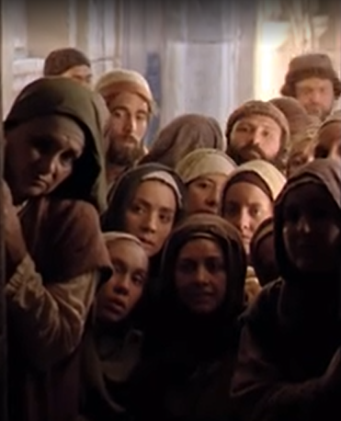
Authority to Forgive
Mark 2:1-12
And again he entered into Capernaum after some days; and it was noised that he was in the house.
2 And straightway many were gathered together, insomuch that there was no room to receive them, no, not so much as about the door: and he preached the word unto them.

Slide 19
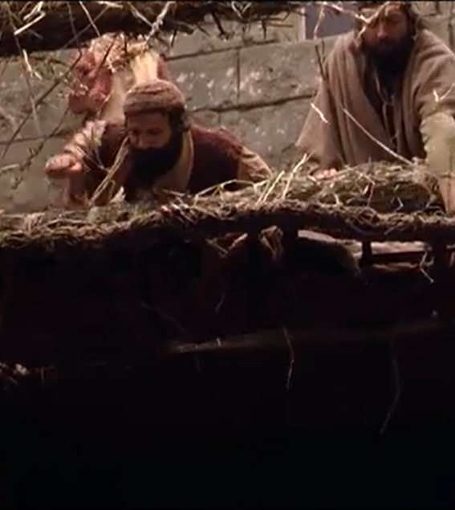
Authority to Forgive
Mark 2:3-12
3 And they come unto him, bringing one sick of the palsy, which was borne of four.
4 And when they could not come nigh unto him for the press, they uncovered the roof where he was: and when they had broken it up, they let down the bed wherein the sick of the palsy lay.

Slide 20
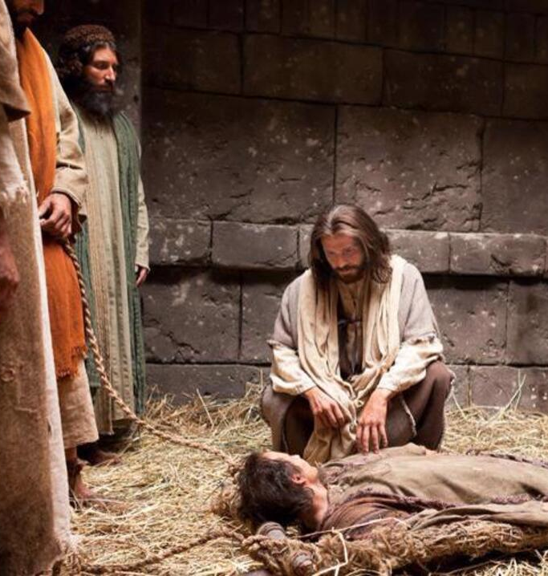
Authority to Forgive
Mark 2:5-12
5 When Jesus saw their faith, he said unto the sick of the palsy, Son, thy sins be forgiven thee.
6 But there was certain of the scribes sitting there, and reasoning in their hearts,
7 Why doth this man thus speak blasphemies? who can forgive sins but God only?

Slide 21
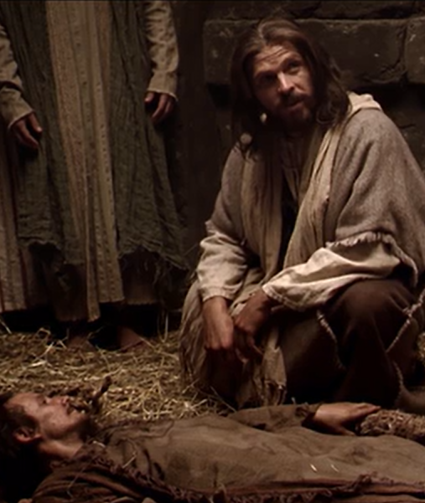
Authority to Forgive
Mark 2:8-12
8 And immediately when Jesus perceived in his spirit that they so reasoned within themselves, he said unto them, Why reason ye these things in your hearts?
9 Whether is it easier to say to the sick of the palsy, Thy sins be forgiven thee; or to say, Arise, and take up thy bed, and walk?

Slide 22

Authority to Forgive
Only God can forgive sins
+
Jesus forgives sins
=
JESUS IS GOD

Slide 23
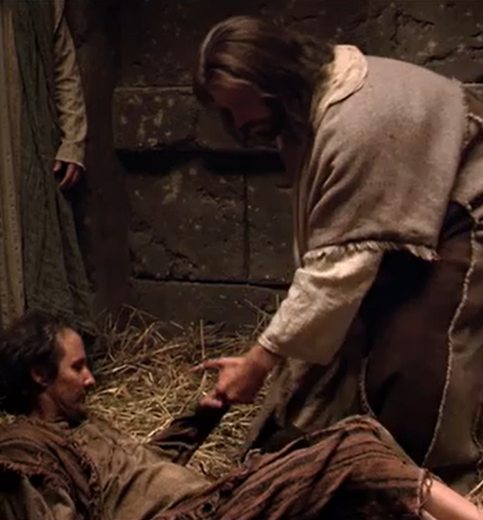
Authority to Forgive
Mark 2:10-12
10 But that ye may know that the Son of man hath power on earth to forgive sins, (he saith to the sick of the palsy,)
11 I say unto thee, Arise, and take up thy bed, and go thy way into thine house.

Slide 24
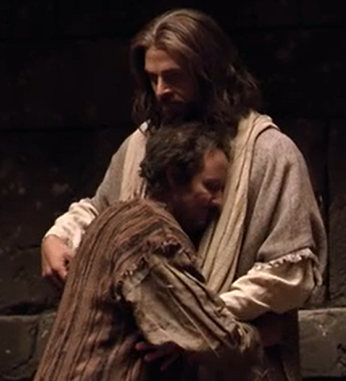
Authority to Forgive
Mark 2:12
12 And immediately he arose, took up the bed, and went forth before them all; insomuch that they were all amazed, and glorified God, saying, We never saw it on this fashion.

Slide 25
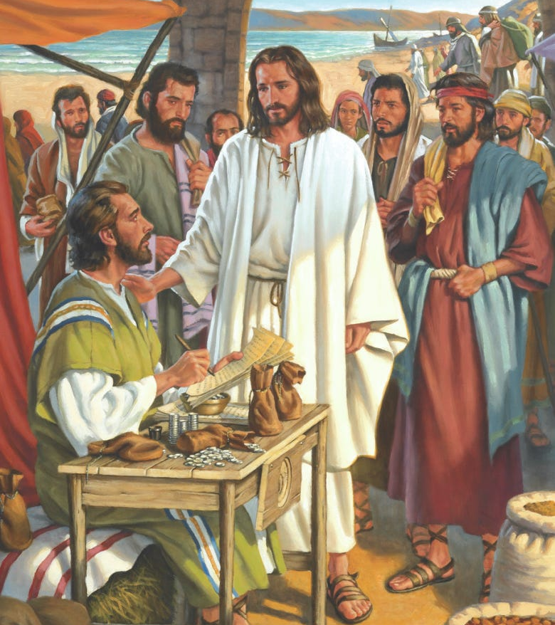
Authority to Call Mark 2:13-17
13 And he went forth again by the sea side; and all the multitude resorted unto him, and he taught them.
14 And as he passed by, he saw Levi the son of Alphaeus sitting at the receipt of custom, and said unto him, Follow me. And he arose and followed him.

Slide 26
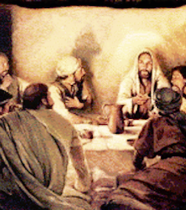
Authority to Call Mark 2:16-17
15 And it came to pass, that, as Jesus sat at meat in his house, many publicans and sinners sat also together with Jesus and his disciples: for there were many, and they followed him.

Slide 27
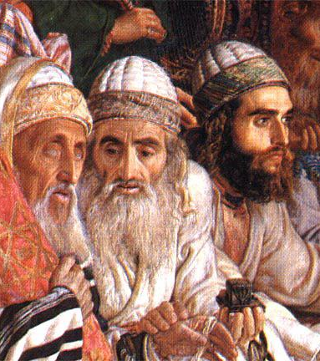
Authority to Call Mark 2:16-17
16 And when the scribes and Pharisees saw him eat with publicans and sinners, they said unto his disciples, How is it that he eateth and drinketh with publicans and sinners?

Slide 28
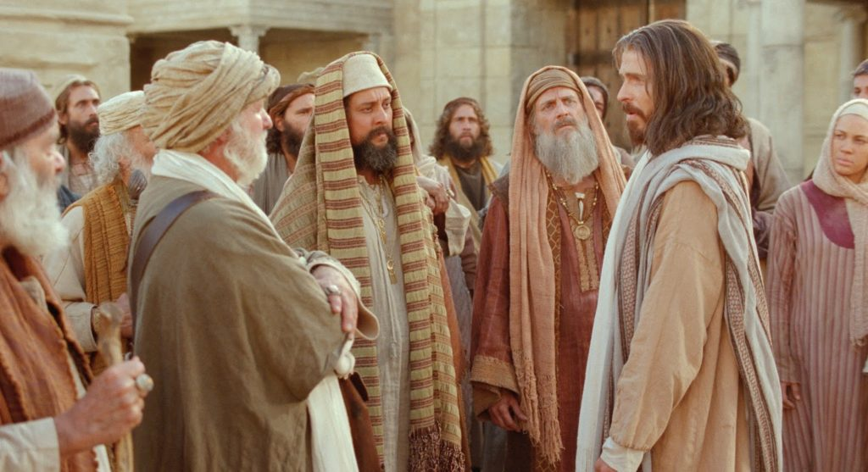
Authority to Call Mark 2:17
17 When Jesus heard it, he saith unto them, They that are whole have no need of the physician, but they that are sick: I came not to call the righteous, but sinners to repentance.

Slide 29
Authority to Call
SDA Bible Commentary on Mark 2:17
“
If the tax collectors were such sinners as the Pharisees claimed, they must be in greater need than other men. Were they not then the very ones for whom Christ should put forth His best efforts? He had come to “save” men (Matt. 1:21), but if He were able only to save those who were already righteous, He could not be truly a Saviour. The test of His mission as the Saviour of men turned on the point of what He could do for sinners.
”

Slide 30
Authority to Call
The Desire of Ages p. 275
“
The Pharisees were silenced for the time, but only became more determined in their enmity. They next sought out the disciples of John the Baptist, and tried to set them against the Saviour. These Pharisees had not accepted the mission of the Baptist. They had pointed in scorn to his abstemious life, his simple habits, his coarse garments, and had declared him a fanatic. Now when Jesus came mingling with the people, eating and drinking at their tables, they accused Him of being a glutton and a winebibber.
”

Slide 31
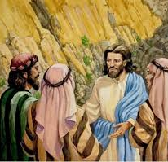
The Bridegroom’s Authority
Mark 2:18-22
18 And the disciples of John and of the Pharisees used to fast: and they come and say unto him, Why do the disciples of John and of the Pharisees fast, but thy disciples fast not?

Slide 32
The Bridegroom’s Authority
The Desire of Ages p. 276
“
The disciples of John were at this time in great sorrow. It was before their visit to Jesus with John's message. Their beloved teacher was in prison, and they passed their days in mourning. And Jesus was making no effort to release John, and even appeared to cast discredit on his teaching. If John had been sent by God, why did Jesus and His disciples pursue a course so widely different?
”

Slide 33
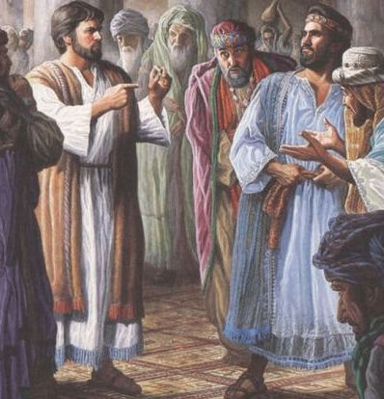
The Bridegroom’s Authority
Mark 2:19-22
19 And Jesus said unto them, Can the children of the bridechamber fast, while the bridegroom is with them? as long as they have the bridegroom with them, they cannot fast.
20 But the days will come, when the bridegroom shall be taken away from them, and then shall they fast in those days.

Slide 34
The Bridegroom’s Authority
SDA Commentary on Mark 2:19
“
The comparison Jesus used here has its roots in Old Testament prophecy, where Jehovah’s relation to His people is depicted as that of the bridegroom to the bride. John had already used the same figure to explain His relationship to the Messiah upon the former occasion when the Jewish leaders had sought to drive a wedge of rivalry between John and Jesus, probably a year or so prior to this occasion. It seems significant, therefore, that Jesus used this brief figure in the presence of the disciples of John the Baptist.
”

Slide 35
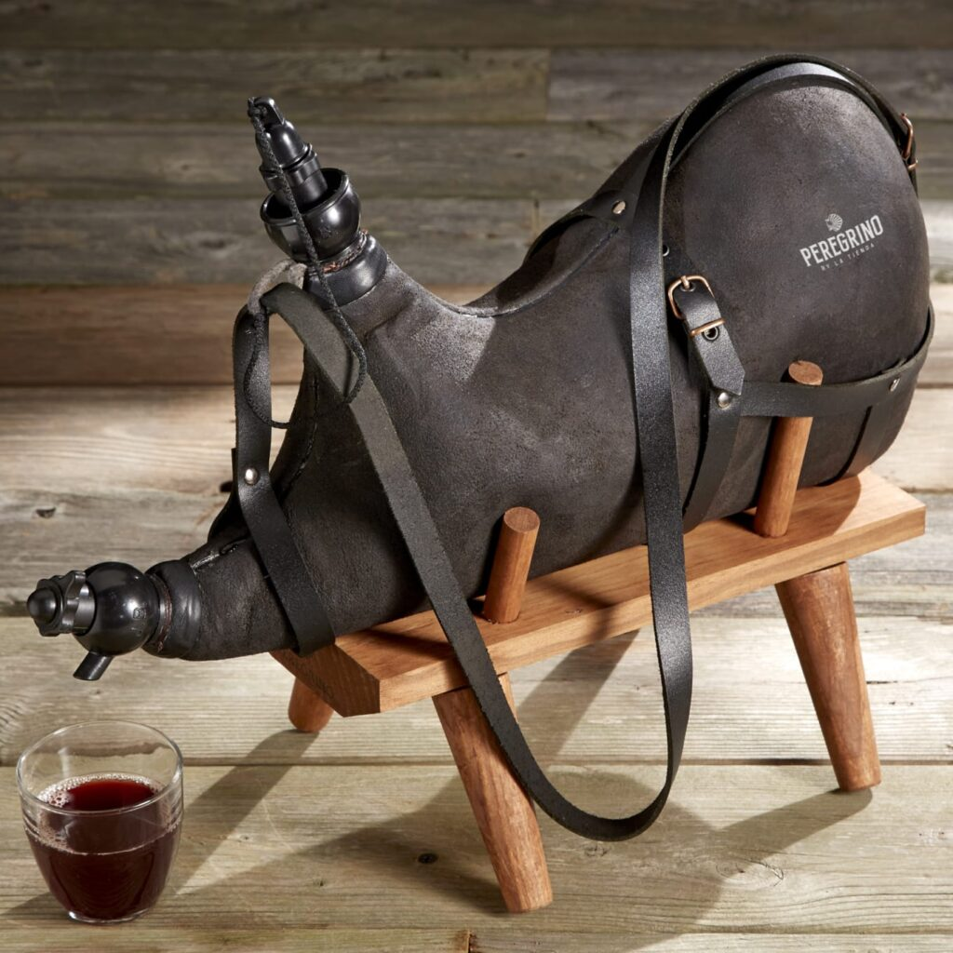
The Bridegroom’s Authority
Mark 2:21-22
21 No man also seweth a piece of new cloth on an old garment: else the new piece that filled it up taketh away from the old, and the rent is made worse.
22 And no man putteth new wine into old bottles: else the new wine doth burst the bottles, and the wine is spilled, and the bottles will be marred: but new wine must be put into new bottles.

Slide 36

Authority over Sabbath
Mark 2:23-28
23 And it came to pass, that he went through the corn fields on the sabbath day; and his disciples began, as they went, to pluck the ears of corn.
24 And the Pharisees said unto him, Behold, why do they on the sabbath day that which is not lawful?

Slide 37
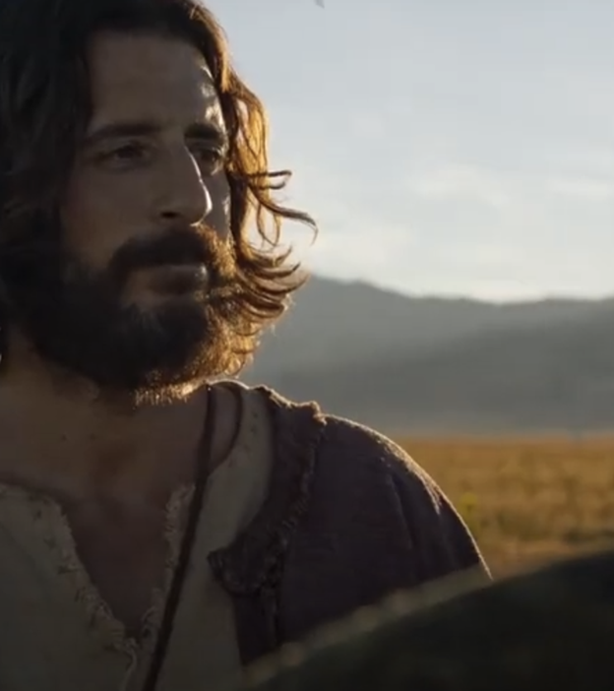
Authority over Sabbath
Mark 2:25-28
25 And he said unto them, Have ye never read what David did, when he had need, and was an hungred, he, and they that were with him?

Slide 38
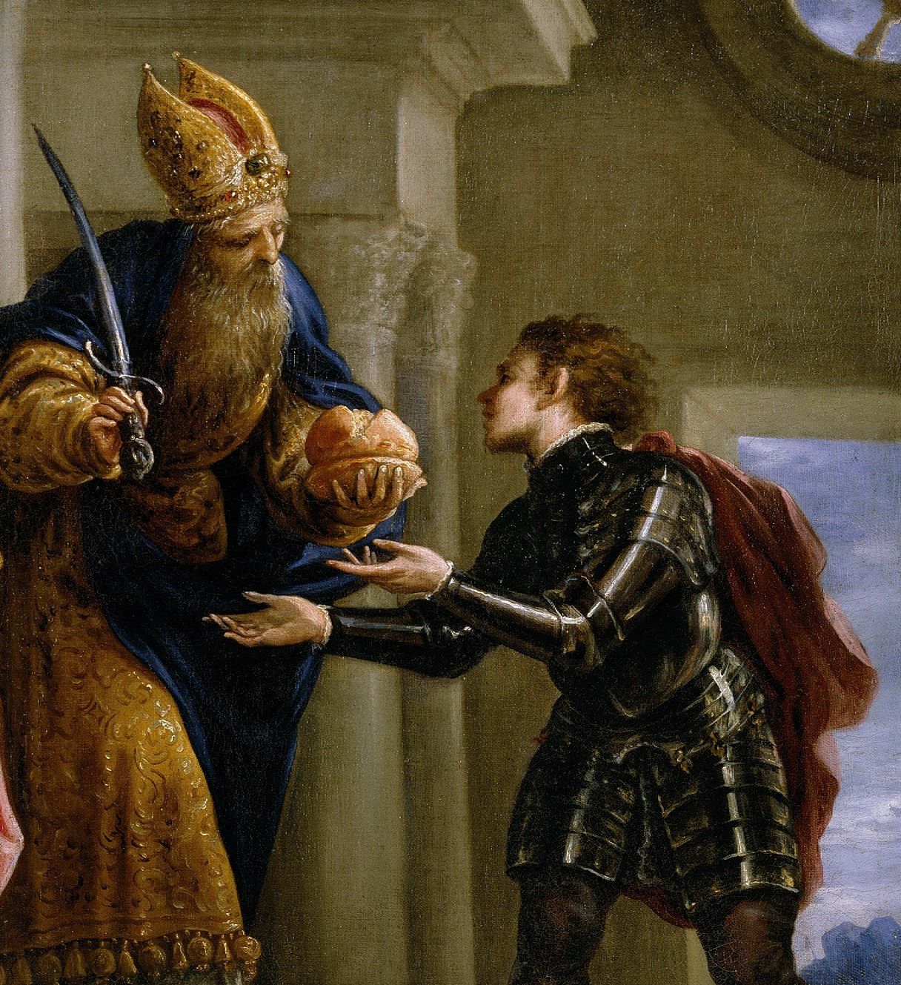
David and the Shewbread
1 Sam. 21:3-6
3 Now therefore what is under thine hand? give me five loaves of bread in mine hand, or what there is present.
4 And the priest answered David, and said, There is no common bread under mine hand, but there is hallowed bread; if the young men have kept themselves at least from women.

Slide 39
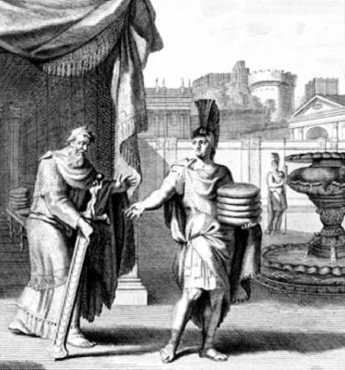
David and the Shewbread
1 Sam. 21:5-6
5 And David answered the priest, and said unto him, Of a truth women have been kept from us about these three days, since I came out, and the vessels of the young men are holy, and the bread is in a manner common, yea, though it were sanctified this day in the vessel.

Slide 40
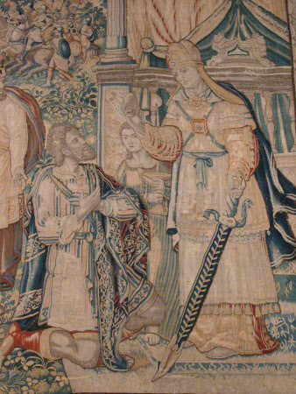
David and the Shewbread
1 Sam. 21:6
6 So the priest gave him hallowed bread: for there was no bread there but the shewbread, that was taken from before the Lord, to put hot bread in the day when it was taken away.

Slide 41
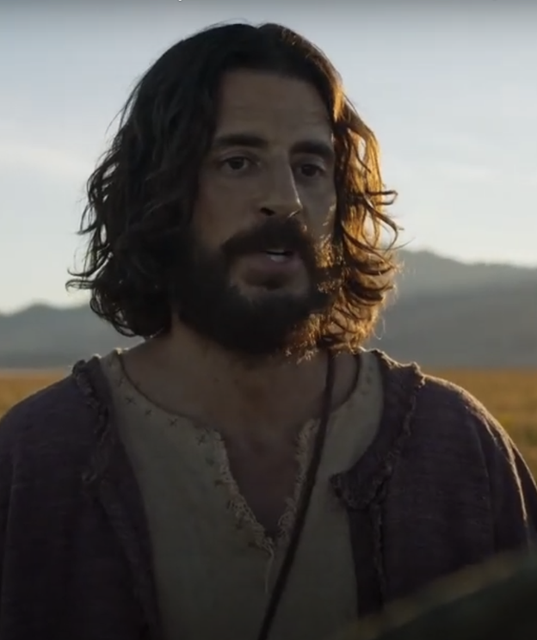
Authority over Sabbath
Mark 2:26-28
26 How he went into the house of God in the days of Abiathar the high priest, and did eat the shewbread, which is not lawful to eat but for the priests, and gave also to them which were with him?

Slide 42
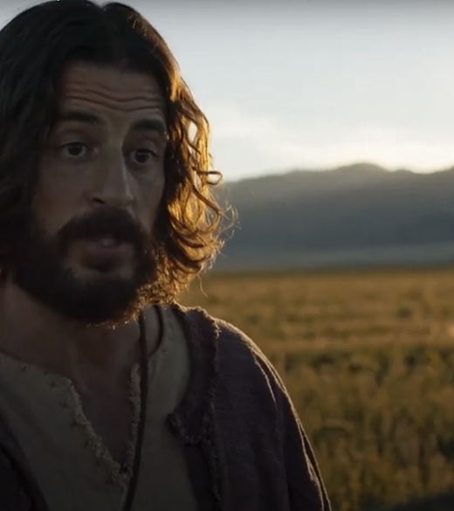
Authority over Sabbath
Mark 2:26-28
27 And he said unto them, The sabbath was made for man, and not man for the sabbath:
28 Therefore the Son of man is Lord also of the sabbath.

Slide 43
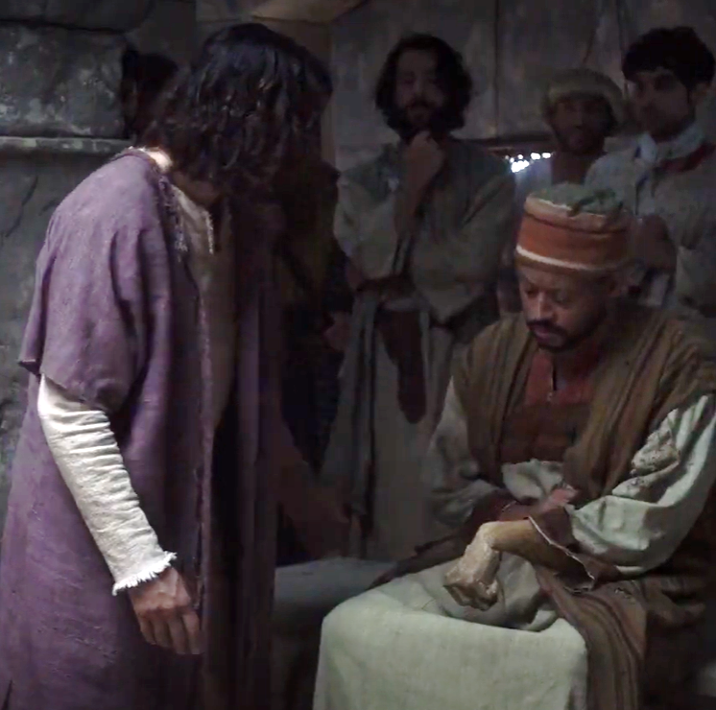
Authority over Sabbath
Mark 3:1-6
And he entered again into the synagogue; and there was a man there which had a withered hand.
2 And they watched him, whether he would heal him on the sabbath day; that they might accuse him.

Slide 44
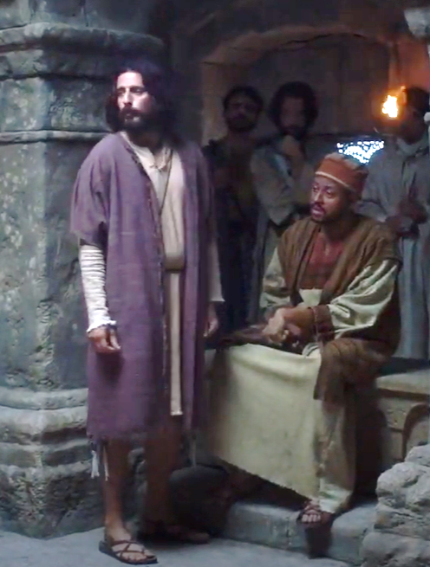
Authority over Sabbath
Mark 3:3-6
3 And he saith unto the man which had the withered hand, Stand forth.
4 And he saith unto them, Is it lawful to do good on the sabbath days, or to do evil? to save life, or to kill? But they held their peace.

Slide 45
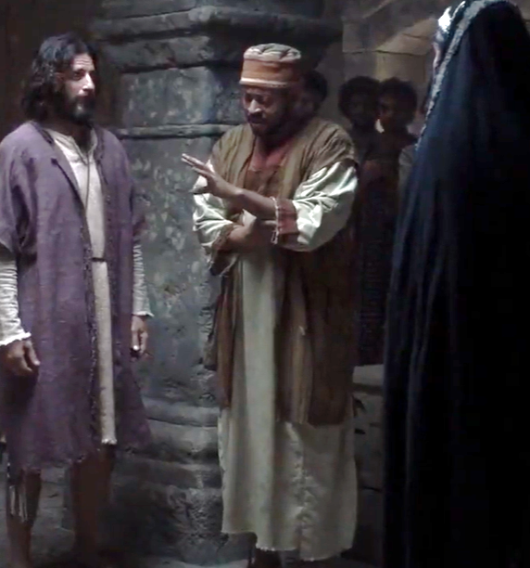
Authority over Sabbath
Mark 3:5-6
5 And when he had looked round about on them with anger, being grieved for the hardness of their hearts, he saith unto the man, Stretch forth thine hand. And he stretched it out: and his hand was restored whole as the other.

Slide 46
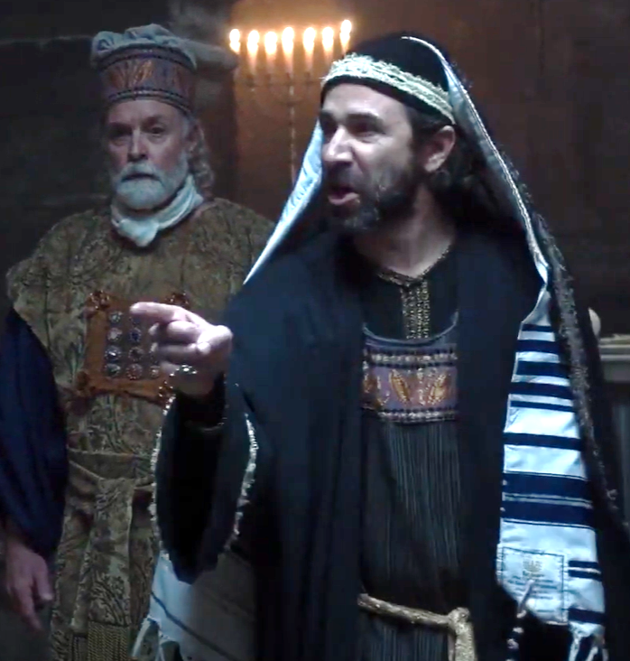
Authority over Sabbath
Mark 3:5-6
6 And the Pharisees went forth, and straightway took counsel with the Herodians against him, how they might destroy him.

Slide 47
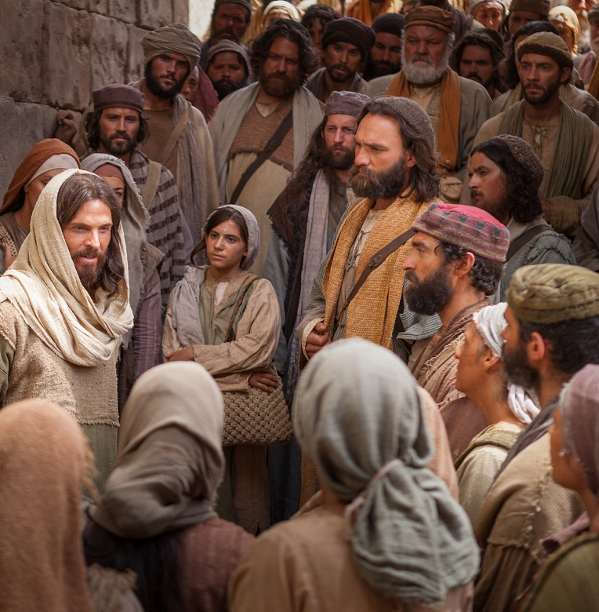
Authority to Cast Out
Mark 3:20-35
20 And the multitude cometh together again, so that they could not so much as eat bread.
21 And when his friends heard of it, they went out to lay hold on him: for they said, He is beside himself.

Slide 48
Authority to Cast Out
The Desire of Ages p.321
“
The sons of Joseph were far from being in sympathy with Jesus in His work. The reports that reached them in regard to His life and labors filled them with astonishment and dismay. They heard that He devoted entire nights to prayer, that through the day He was thronged by great companies of people, and did not give Himself time so much as to eat.
”

Slide 49
Authority to Cast Out
The Desire of Ages p.321
“
His friends felt that He was wearing Himself out by His incessant labor; they were unable to account for His attitude toward the Pharisees, and there were some who feared that His reason was becoming unsettled.
”

Slide 50
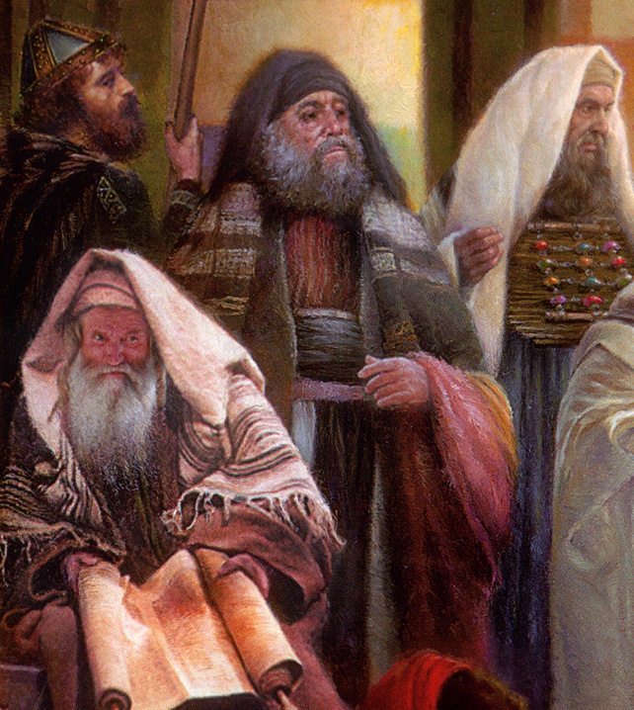
Authority to Cast Out
Mark 3:22-35
22 And the scribes which came down from Jerusalem said, He hath Beelzebub, and by the prince of the devils casteth he out devils.
23 And he called them unto him, and said unto them in parables, How can Satan cast out Satan?

Slide 51
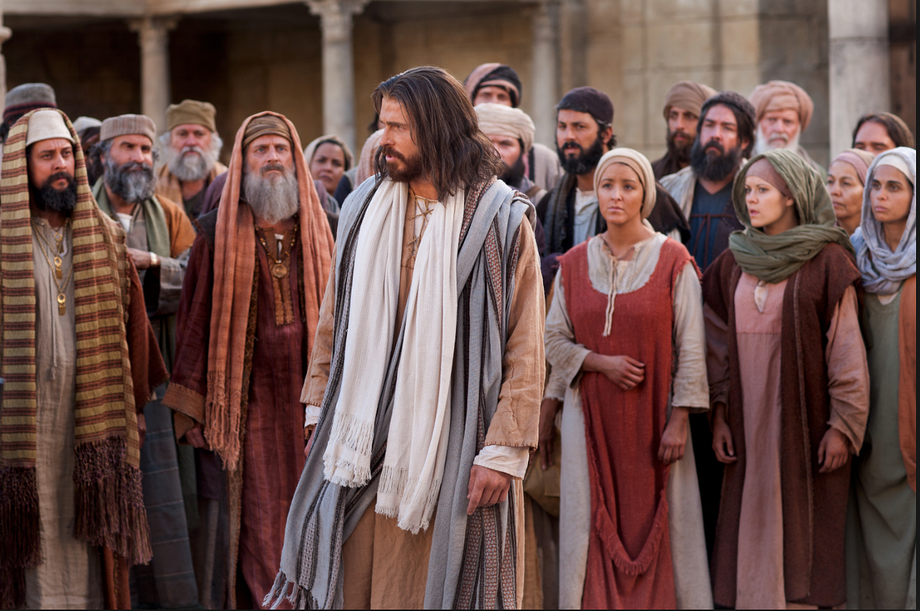
Authority to Cast Out
Mark 3:24-35
24 And if a kingdom be divided against itself, that kingdom cannot stand.
25 And if a house be divided against itself, that house cannot stand.
26 And if Satan rise up against himself, and be divided, he cannot stand, but hath an end.

Slide 52
Authority to Cast Out
The Desire of Ages p.322
“
The Pharisees to whom Jesus spoke this warning did not themselves believe the charge they brought against Him. There was not one of those dignitaries but had felt drawn toward the Saviour. They had heard the Spirit's voice in their own hearts declaring Him to be the Anointed of Israel….But after their rejection of Him it would be too humiliating to receive Him as the Messiah. Having set their feet in the path of unbelief, they were too proud to confess their error.
”

Slide 53
Authority to Cast Out
Mark 3:27-35
27 No man can enter into a strong man's house, and spoil his goods, except he will first bind the strong man; and then he will spoil his house.
28 Verily I say unto you, All sins shall be forgiven unto the sons of men, and blasphemies wherewith soever they shall blaspheme:

Slide 54
Authority to Cast Out
Mark 3:29-35
29 But he that shall blaspheme against the Holy Ghost hath never forgiveness, but is in danger of eternal damnation.
30 Because they said, He hath an unclean spirit.

Slide 55
Authority to Cast Out
The Desire of Ages p.321
“
Jesus’ brothers heard of this…They felt keenly the reproach that came upon them through their relation to Jesus. They knew what a tumult His words and works created, and were not only alarmed at His bold statements, but indignant at His denunciation of the scribes and Pharisees.
”

Slide 56
Authority to Cast Out
The Desire of Ages p.321
“
They decided that He must be persuaded or constrained to cease this manner of labor, and they induced Mary to unite with them, thinking that through His love for her they might prevail upon Him to be more prudent.
”

Slide 57
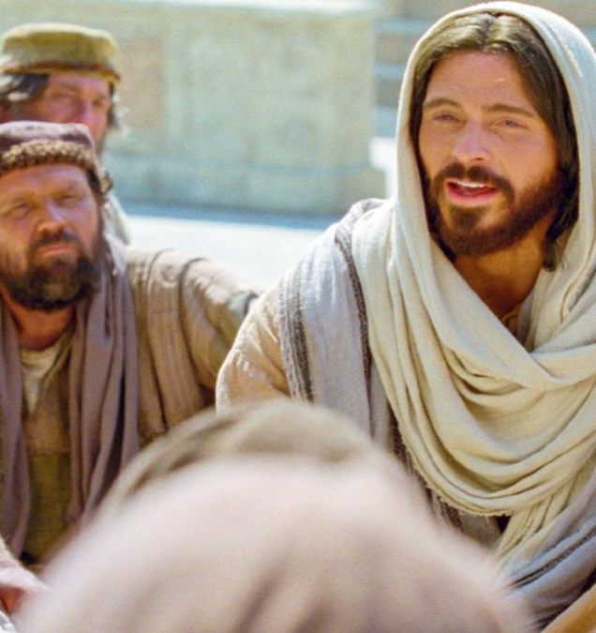
Authority to Cast Out
Mark 3:31-35
31 There came then his brethren and his mother, and, standing without, sent unto him, calling him.
32 And the multitude sat about him, and they said unto him, Behold, thy mother and thy brethren without seek for thee.
33 And he answered them, saying, Who is my mother, or my brethren?

Slide 58
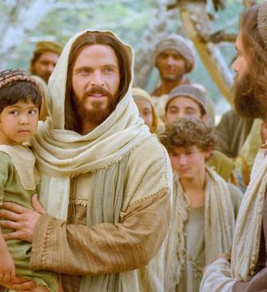
Authority to Cast Out
Mark 3:31-35
34 And he looked round about on them which sat about him, and said, Behold my mother and my brethren!
35 For whosoever shall do the will of God, the same is my brother, and my sister, and mother.

Slide 59
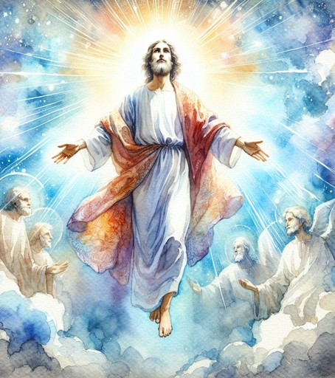
ALL AUTHORITY
Matthew 28:18-20
18 And Jesus came and spake unto them, saying, All power is given unto me in heaven and in earth.

Slide 60
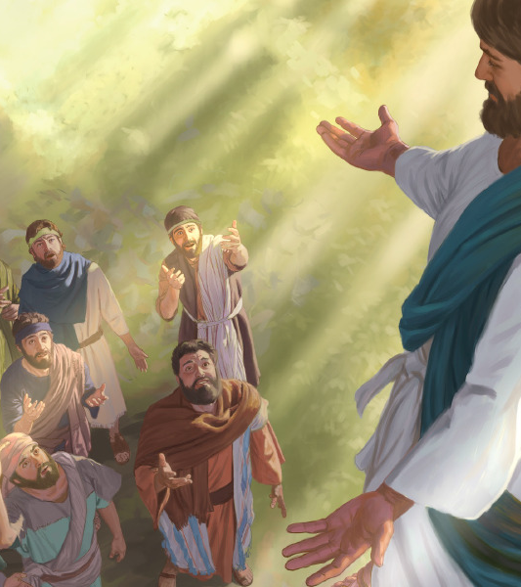
ALL AUTHORITY
Matthew 28:19-20
19 Go ye therefore, and teach all nations, baptizing them in the name of the Father, and of the Son, and of the Holy Ghost:

Slide 61
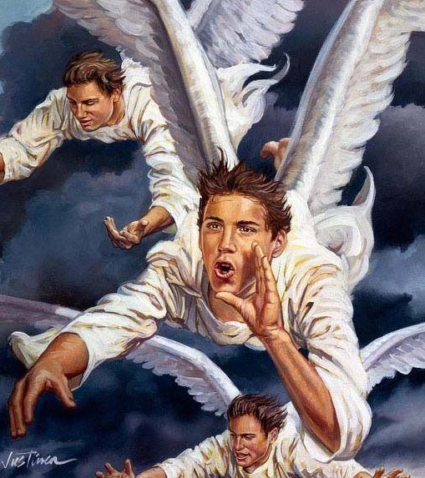
ALL AUTHORITY
Matthew 28:20
20 Teaching them to observe all things whatsoever I have commanded you: and, lo, I am with you always, even unto the end of the world. Amen.

Slide 62
15 These things speak, and exhort, and rebuke with all authority. Let no man despise thee.
The Great Commission extends to Christ’s followers the AUTHORITY to teach as He did!
Titus 2:15

Slide 63
Thank you!
Happy Sabbath!!

